Slide 1
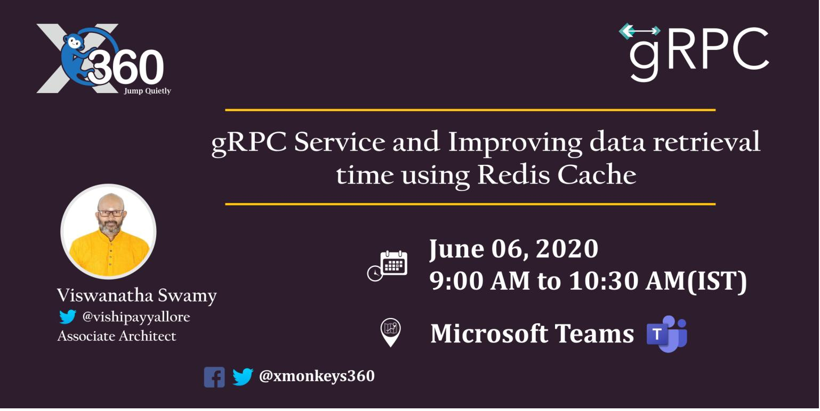
Session 3 of 10
Viswanatha Swamy
LinkedIn: https://www.linkedin.com/in/viswanatha-swamy-b57326128/
Twitter: https://twitter.com/vishipayyallore
XMonkeys360

Slide 2
Information
Today is session 3.
All the sessions will be hands on.
Sessions will be weekly.
Will have parking lots for queries and other topics.
Some of the concepts we will introduced and revisited in next sessions.
There are multiple ways to do, we will use one of the way.
The focus was more on concepts and demos are kept simple.
I am still a learner. What!!! … wait … Yes, I am still a learner.
XMonkeys360

Slide 3
Tools we use
Visual Studio 2019 Professional
Azure Data Studio
SQL Server
Redis Server
XMonkeys360

Slide 4

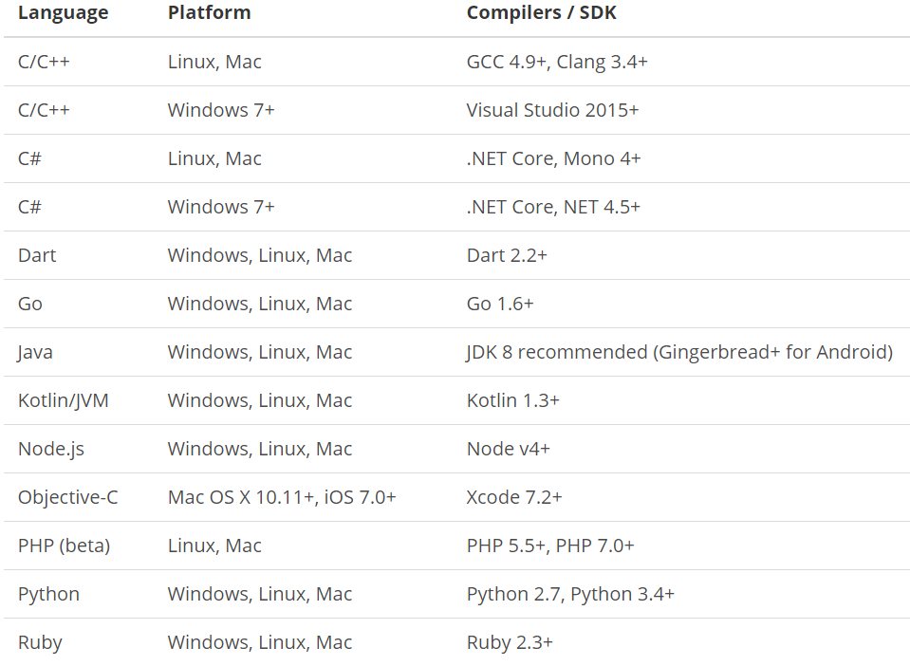
What is gRPC ?
is a modern open source high performance RPC framework that can run in any environment. It can efficiently connect services in and across data centers with pluggable support for load balancing, tracing, health checking and authentication. It is also applicable in last mile of distributed computing to connect devices, mobile applications and browsers to backend services.
https://docs.microsoft.com/en-us/aspnet/core/tutorials/grpc/grpc-start?view=aspnetcore-3.1&tabs=visual-studio
https://grpc.io/docs/guides/
https://grpc.io/docs/guides/concepts/
Motivation:
High Performance
IDL / Contract Based
Streaming (Unary, Client, Server, Bi-directional)
Security (https://developers.google.com/web/fundamentals/performance/http2)
Available across ecosystems
Supported Languages:
URL: https://grpc.io/about/#officially-supported-languages-and-platforms
XMonkeys360

Slide 5
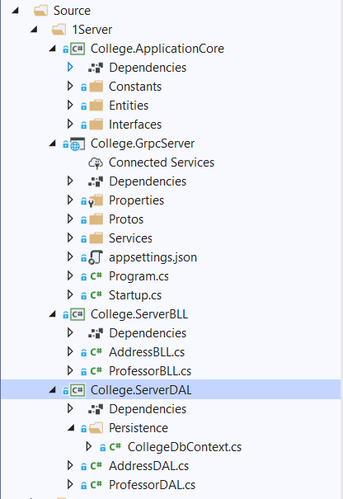
Existing gRPC Service and Clients
College.ApplicationCore:
Constants
Entities
Interfaces
College.GrpcServer:
.Proto files
gRPC Server implementations
Application Configuration
Start up and DI
College.ServerBLL:
Any Business Logic
College.ServerDAL:
Db Context
Data Access Layer which consumes Db Context
XMonkeys360

Slide 6
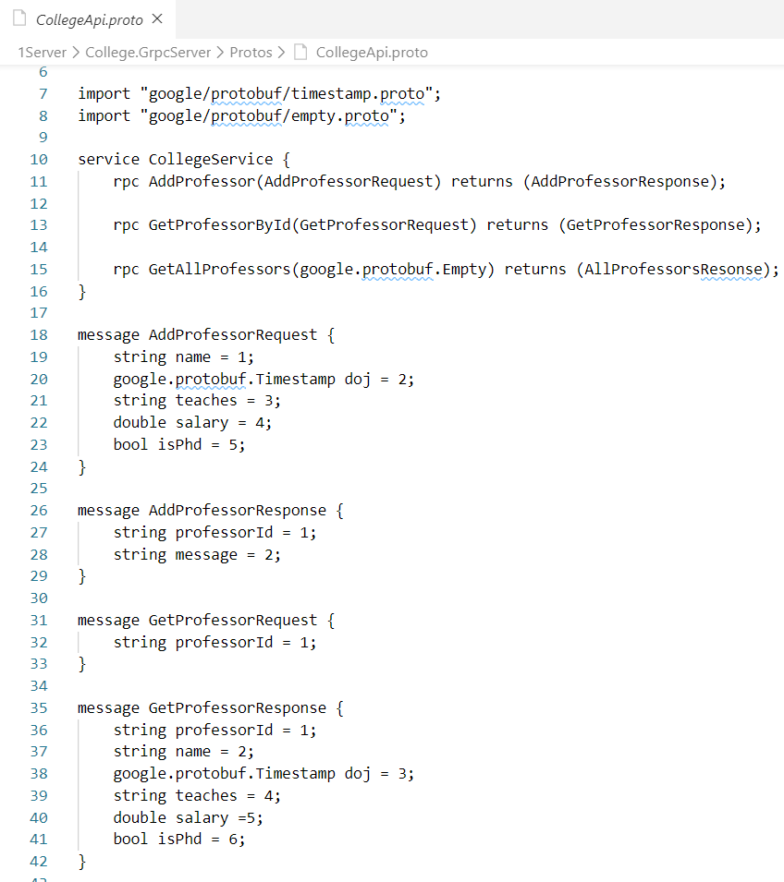
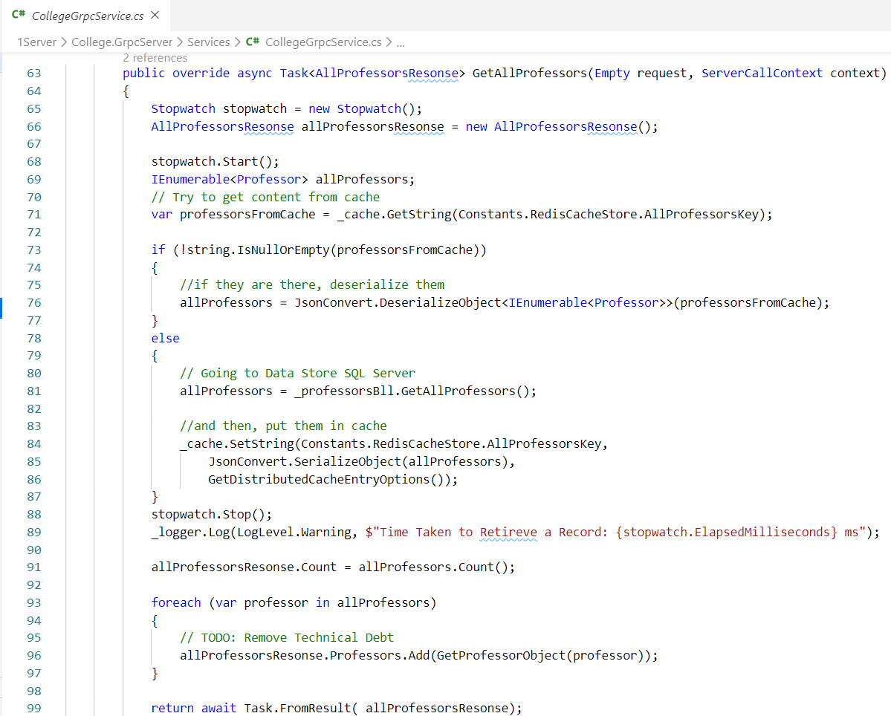
Adding Retrieval All and Retrieve By Id inside Service
XMonkeys360

Slide 7
Adding Retrieval All and Retrieve By Id inside Service
Demo
Adding RetrieveAll() and
RetrieveById() in
gRPC Server
XMonkeys360

Slide 8
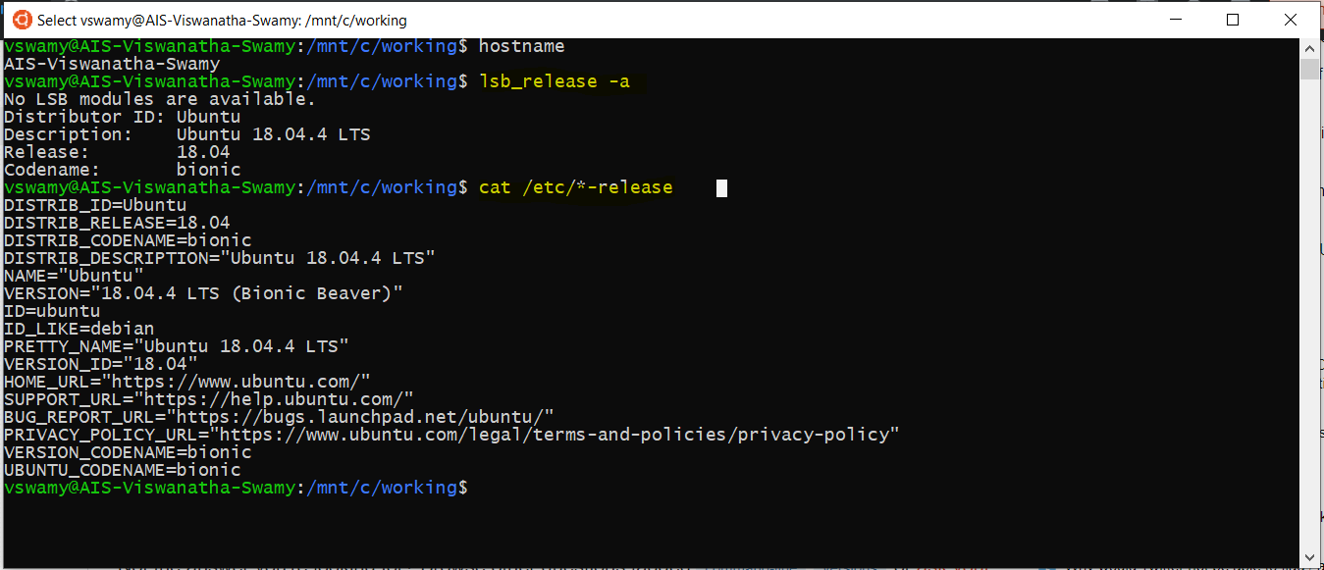
Install WSL on Windows 10
Please refer official documentation for detailed steps. URL: https://docs.microsoft.com/en-us/windows/wsl/install-win10
XMonkeys360

Slide 9
Install WSL on Windows 10
Demo
Verify the WSL on Windows 10
hostname
lsb_release -a
cat /etc/*-release
XMonkeys360

Slide 10
Install Redis Cache on WSL on Windows 10
Please refer official documentation for detailed steps. URL: https://redislabs.com/blog/redis-on-windows-10/
Install Redis Cache on WSL on Windows 10
sudo apt-get update
sudo apt-get upgrade
sudo apt-get install redis-server
To Start and Stop the Redis Service
sudo service redis-server restart
sudo service redis-server stop
To Start and Stop the Redis Service
redis-server -v
redis-cli -v
To Connect to Redis Server
redis-cli
XMonkeys360

Slide 11
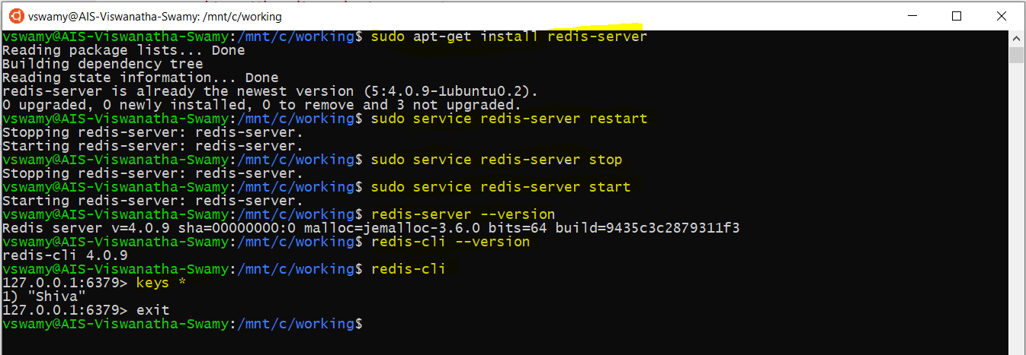
Install Redis Cache on WSL on Windows 10
XMonkeys360

Slide 12
Install Redis Cache on WSL on Windows 10
Demo
Install Redis Cache
on WSL on Windows 10
XMonkeys360

Slide 13

What is next?
What is next ???
What we will discuss in next session (20-Jun-2020) ….
Adding Console Logging into gRPC Server and Client.
Adding Error Handling into gRPC Server and Client.
Adding gRPC service inside an existing ASP.Net Core Web API.
Implement console application as a client for gRPC inside ASP.Net Core Web API.
Adding gRPC Client inside an existing ASP.Net Core Web API. [This Web API Acts as Server and Client]
XMonkeys360

Slide 14
Q & A
XMonkeys360

Slide 15
Thank You
Viswanatha Swamy
LinkedIn: https://www.linkedin.com/in/viswanatha-swamy-b57326128/
Twitter: https://twitter.com/vishipayyallore
XMonkeys360

